Slide 1

BOOK RE-USE
Mini-Project (PMC2216)
Glenn George Thomas (22PMC124)

Slide 2
TABLE OF CONTENTS
01
02
03
04
ABSTRACT
PROJECT REQUIREMENTS
Features & Highlights
Technical Aspects
05
06
07
08
Challenges Faced
FUTURE ENHANCEMENT
CONCLUSION
SCREENSHOTS

Slide 3
ABSTRACT
01
Intended for book enthusiasts
Books that are useless for us might be useful for others
Cheap used books
Sellers provide book details, price & their contact info
Buyers can buy books and contact its sellers if needed

Slide 4
PROJECT REQUIREMENTS
Users :
Admin :
02
Register & Login
Sell Book
Buy Book
Manage Books
Payment
About Us
Dashboard
Manage Book
Manage User

Slide 5
Features & Highlights
03
Registration & Login : User can register and login themselves using Django User.
Sell Book : Authenticated user can sell book
Buy Book : Authenticated user can buy book
Manage Book : An authenticated user can update and delete book (admin also)
Payment : Redirects to a dummy payment gateway
About Us
Manage User : Admin can manage users

Slide 6





Technical Aspects
Django Framework
Third-Party Libraries
Django Jazzmin
04
Django Crispy Forms
Django Pillow

Slide 7
ARCHITECTURE OF PROJECT
Presentation Layer
User interface
Views & forms
Application Layer
Data Layer
database

Slide 8
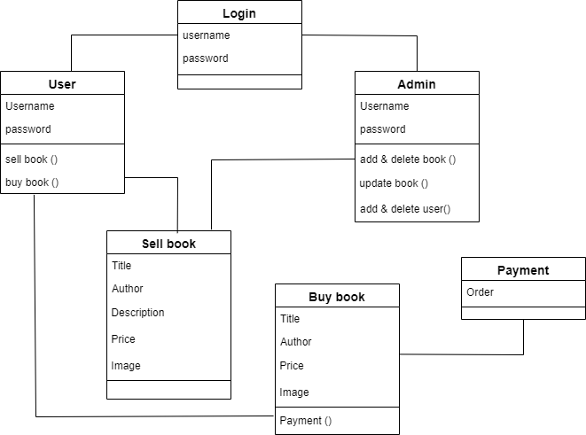
CLASS DIAGRAM

Slide 9


CHALLENGES FACED
05
Identifying and managing the requirements
Time Constraint
Difficulties in Django User
Integrating Crispy Forms
Using Third-Party Libraries

Slide 10
FUTURE ENHANCEMENT
06
Delivery Tracking
User Interface
User Profile
Accessibility
Payment Redirection
Request Books
Add to Cart

Slide 11
CONCLUSIONS
07
A site focusing on book lovers
Buy useful books at low price
Helpful for less fortunate students
Buy and sell books

Slide 12
REFERENCES
08
https://docs.djangoproject.com/en/4.2/
https://getbootstrap.com/docs/5.0/getting-started/introduction/
https://django-crispy-forms.readthedocs.io/
https://pypi.org/project/Pillow/
https://django-jazzmin.readthedocs.io/
https://openai.com/

Slide 13
SCREENSHOTS
09

Slide 14
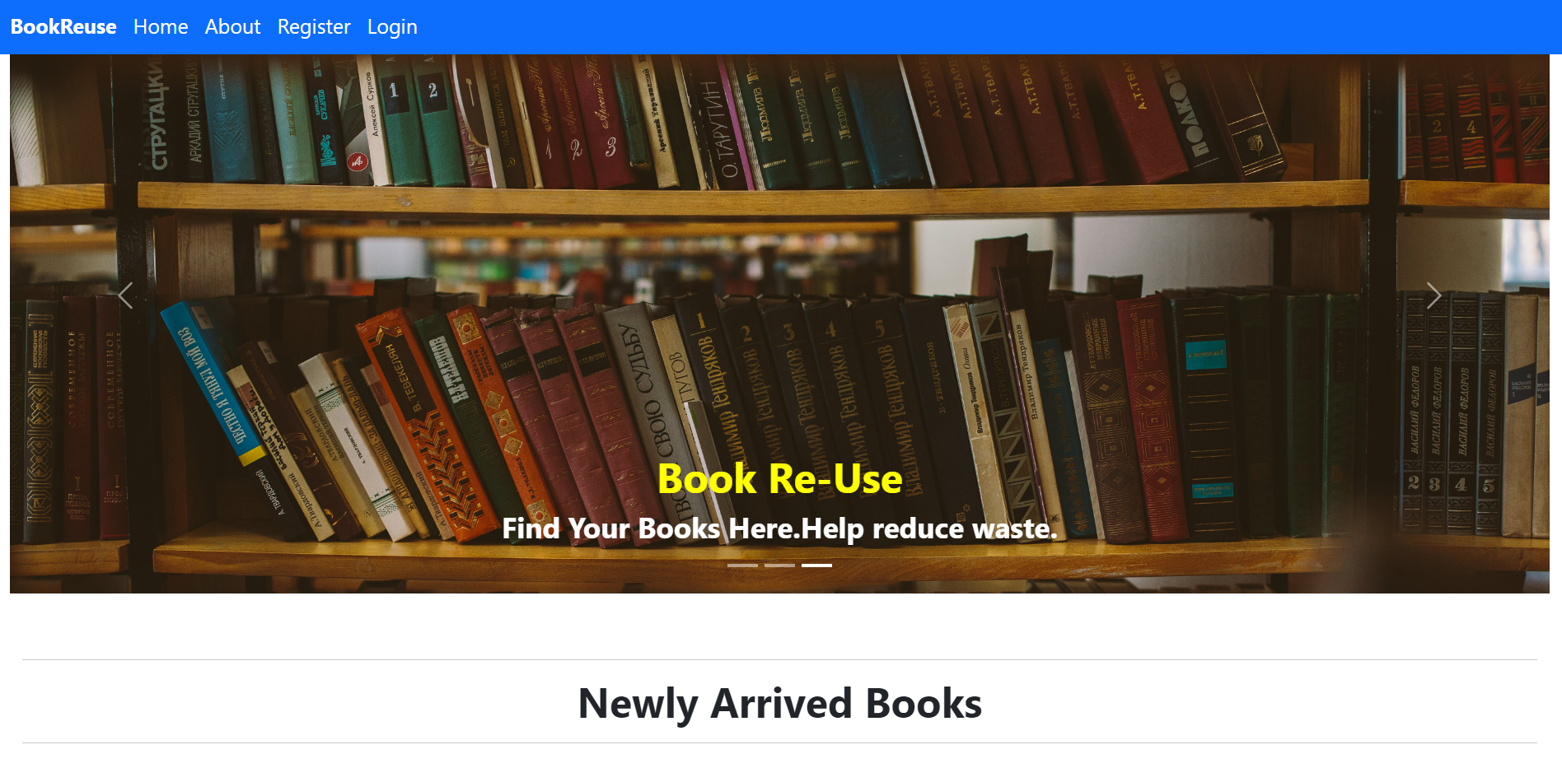
Home Page

Slide 15
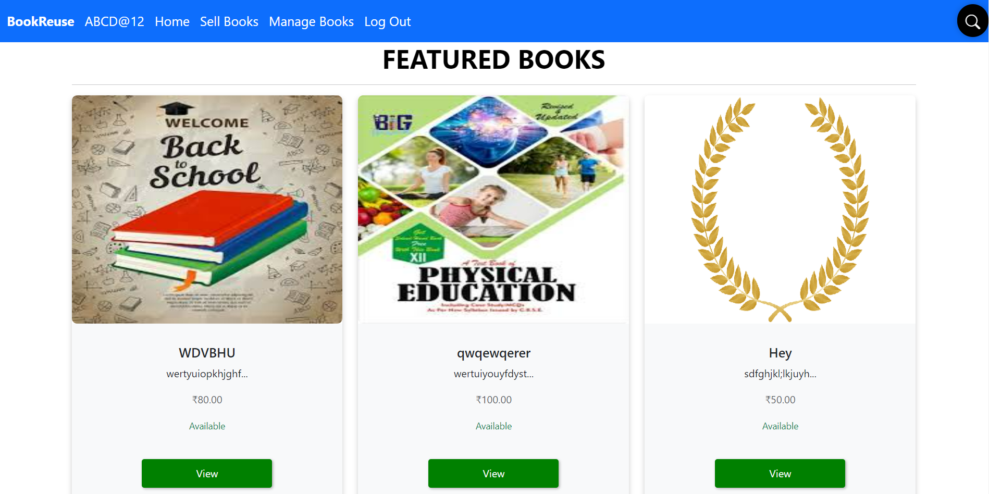
User Home Page

Slide 16
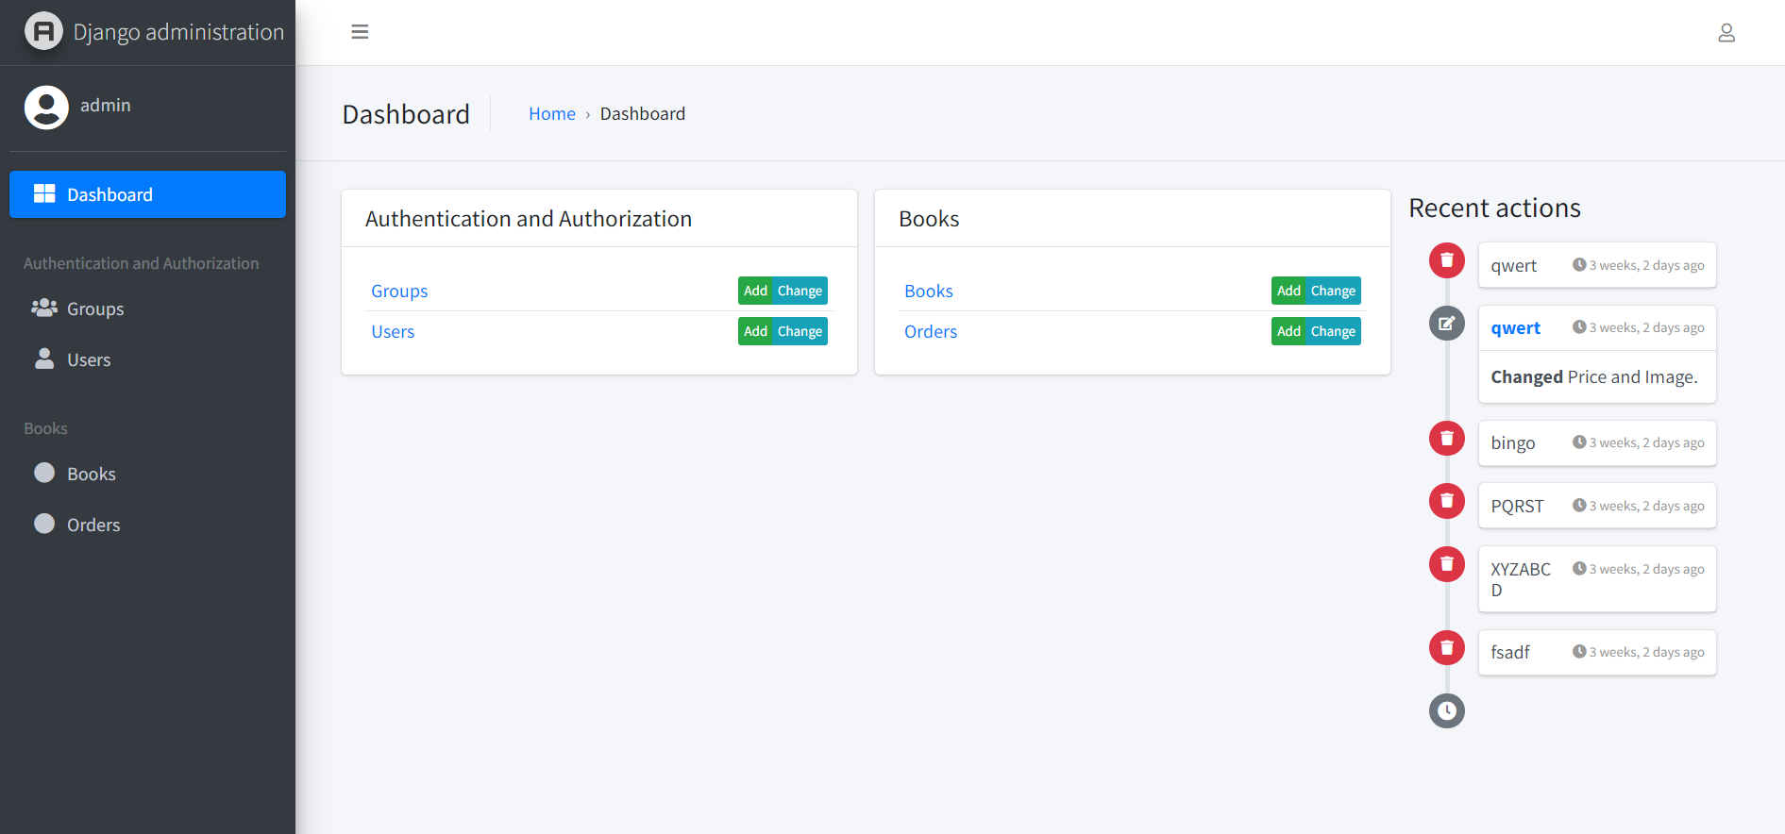
Admin Page :

Slide 17

THANK YOU

